Slide 1


Slide 2
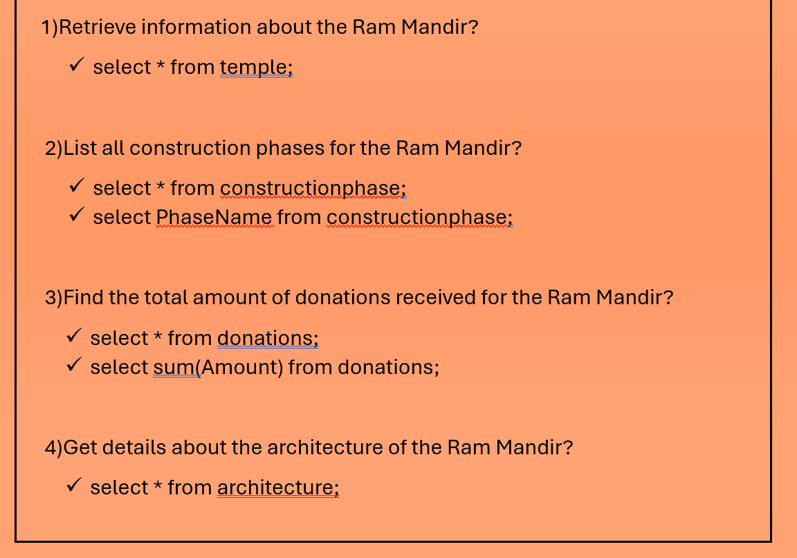

Slide 3
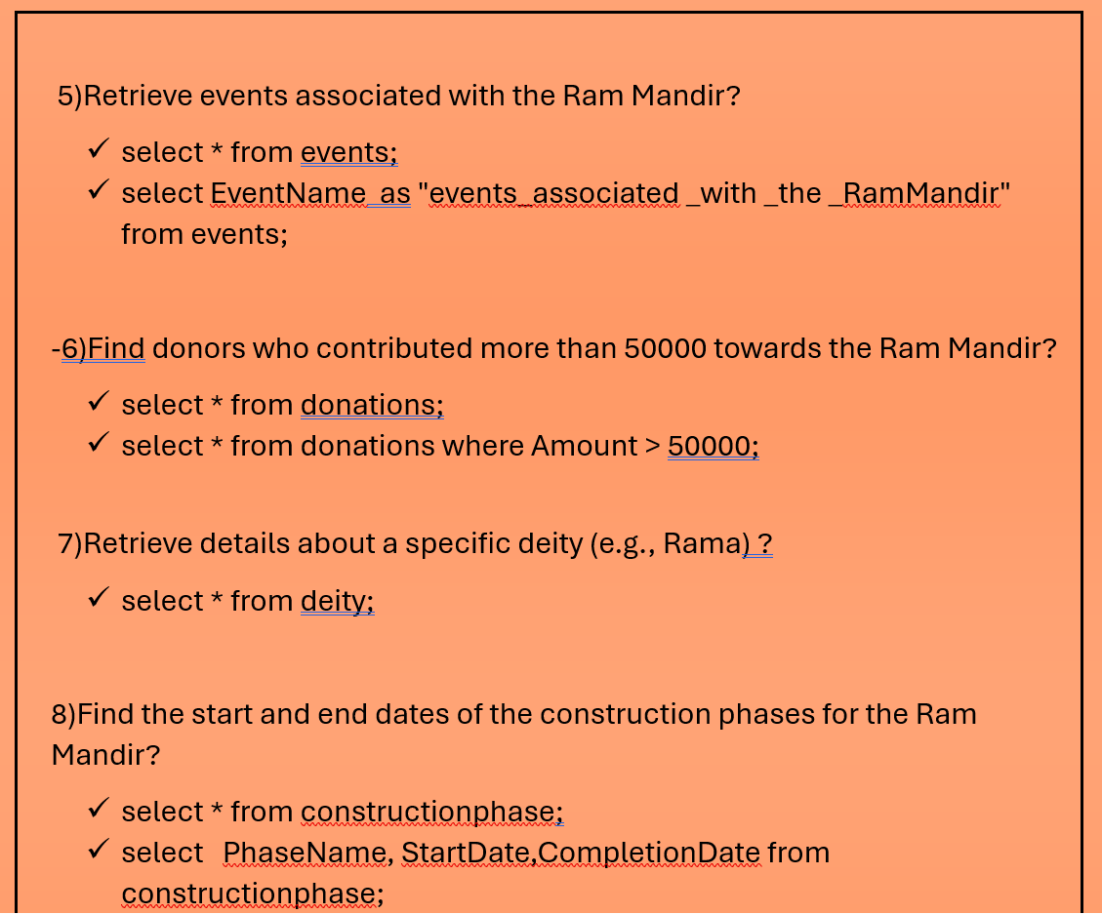

Slide 4
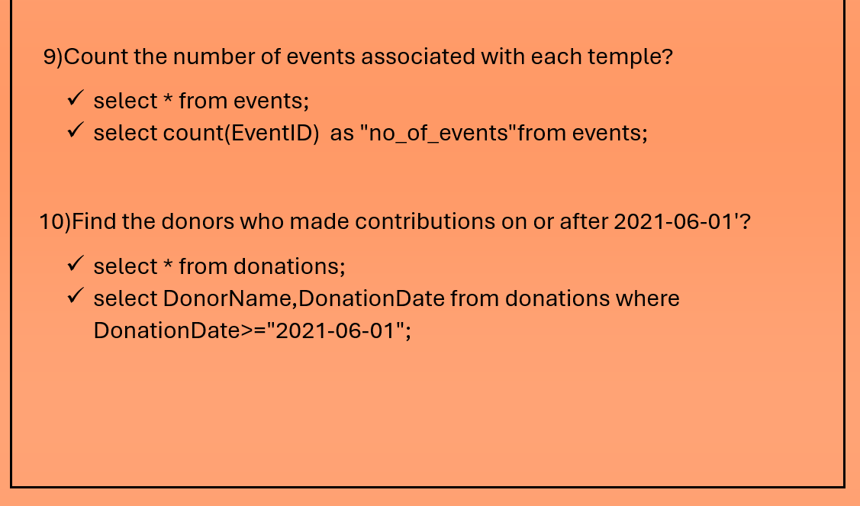

Slide 5

THANK YOU
This Photo by Unknown Author is licensed under CC BY-SA

